Slide 1
Performing Arts Venues Mapping
Coursera IBM Capstone Project

Slide 2
Problem statement
You are a performing arts organizing agency whose mainstream source of revenue is organizing sensational events/gigs for public entertainment from conception to execution.
One of the major decisions that have to be made is the selection of an appropriate venue for a performance.
For this, the agency needs not only a holistic list of venues in an area but also to group it with tags like nightlife, small scale, relevant performance art that can be performed here, etc. So that an optimal decision can be arrived at.

Slide 3
Target audience and Utility
Would be of tremendous utility to all companies/agencies involved in any subdomain of the performing arts ecosystem.
An individual comic/ group of comics scouting for popular locations to perform and showcase their gigs throughout a particular city/area.
Musical Bands/ individual performers looking for crowded venues and popular locations to perform frequently to increase ticket sales.
Play actors/ dance performers and a host of other performing artists aiming to maximize the reach, popularity, and ticket sales for their art.
Supporting staff like choreographers, songwriters, scriptwriters, cameramen, etc looking for employment opportunities.

Slide 4
Dataset fabrication
The aim is to construct a comprehensive, all-encompassing database of venues, complete with useful labels like enabled night shows, the scale of the event that can be hosted, etc.
One would have to partition the geographical area of interest into non-overlapping subsets of the critical sizeThe query will be run on the center of the geographical confine and relevant properties of the results will be used to populate a dataset for further use.
The foursquare API for venue search has a cap of 30 results for a given query, implying that all the popular performing arts venues might not be revealed if the area size exceeds a critical size (at which any further decrement in size would decrease the query results to below 30).

Slide 5
Area of Interest and Description
Milan is the capital of Lombardia, along with being the richest and most populous region of Italy, it is the second-largest in the country.
Zone 1 of Milan city comprises within it, districts of Brera and Porta Sempione, which bubble with its richness of Art and Nightlife.
The whole area is one of the centers of the so-called Milanese Movida (nightlife), with a number of bars, pubs, restaurants, and discos; since the RAI public television company, as well as some major radio stations, have their headquarters in the area, frequent appearances of celebrities contribute to the popularity of the Sempione's nightlife venues.

Slide 6
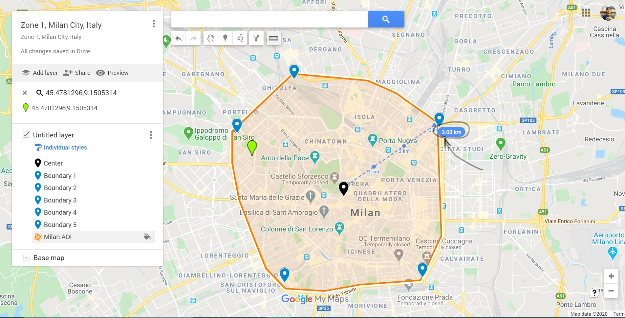

Slide 7
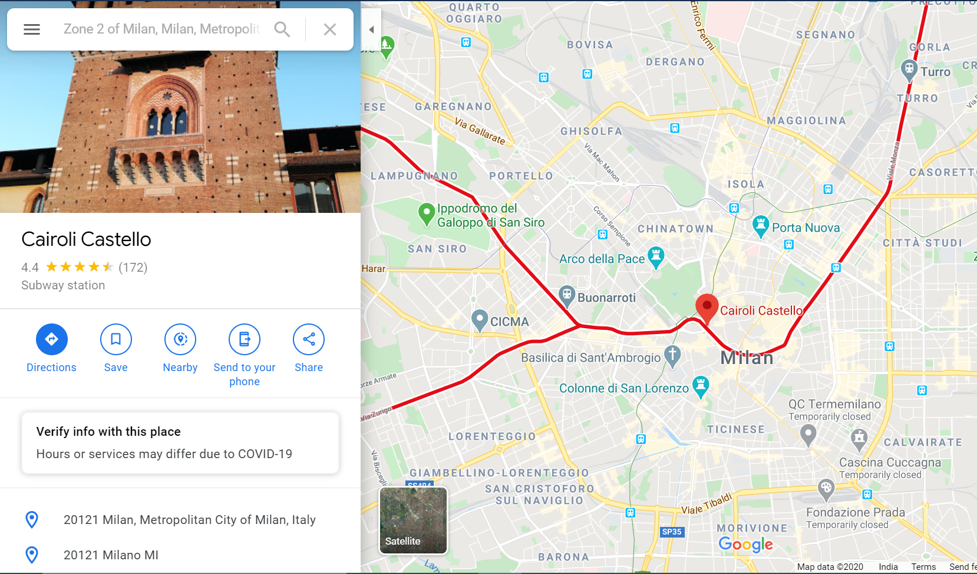

Slide 8
Relevant Location types:
Categories = [Opera House, General Entertainment, Concert Hall, Comedy Club, Amphitheater, Music Venue, Nightclub, Lounge, Theater] are the unique categories to be included in the project.

Slide 9
Cartesian Implementation:
The venues API must be called at every rectangular cell of the grid by specifying its South-West and North-East corner. This 3.0Km radius region around the Center must be sliced into grids of cell size of the ‘critical size’.
As a first step, let’s try to solve this problem on the Cartesian Plane and Visualize it using Matplotlib.
The ‘make_grid(R,S)’ function takes in a radius(R) as an argument and divides the circle and generates a grid of square cells each of side S.

Slide 10
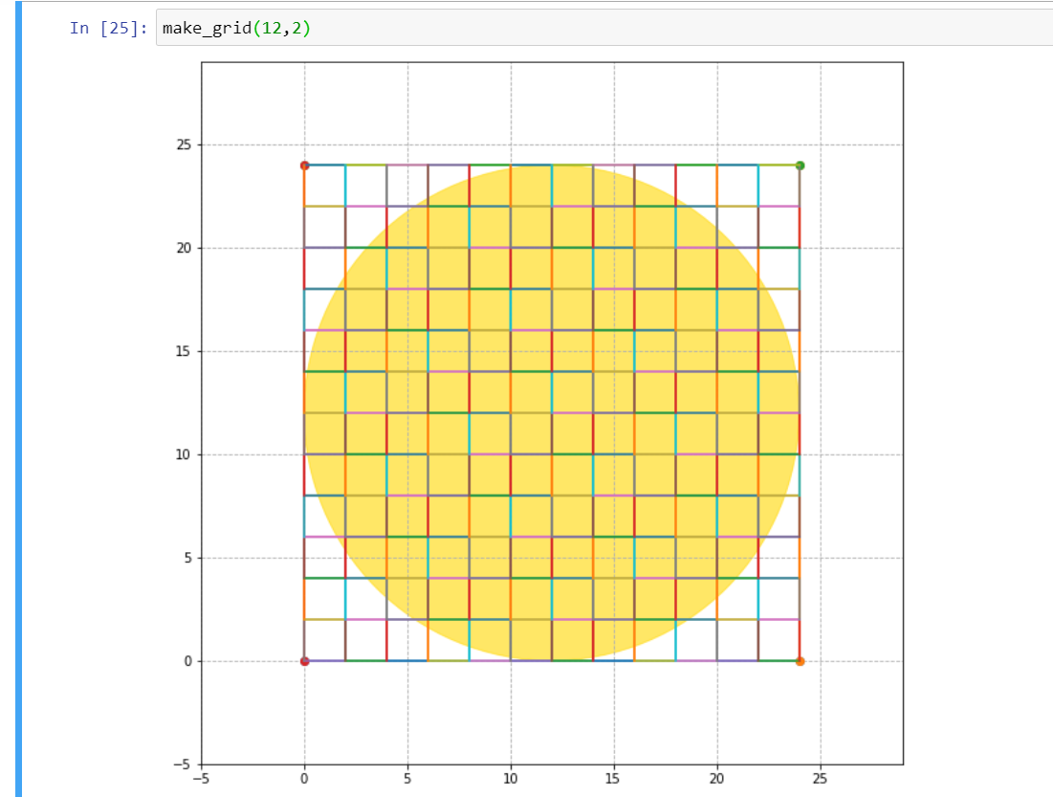

Slide 11
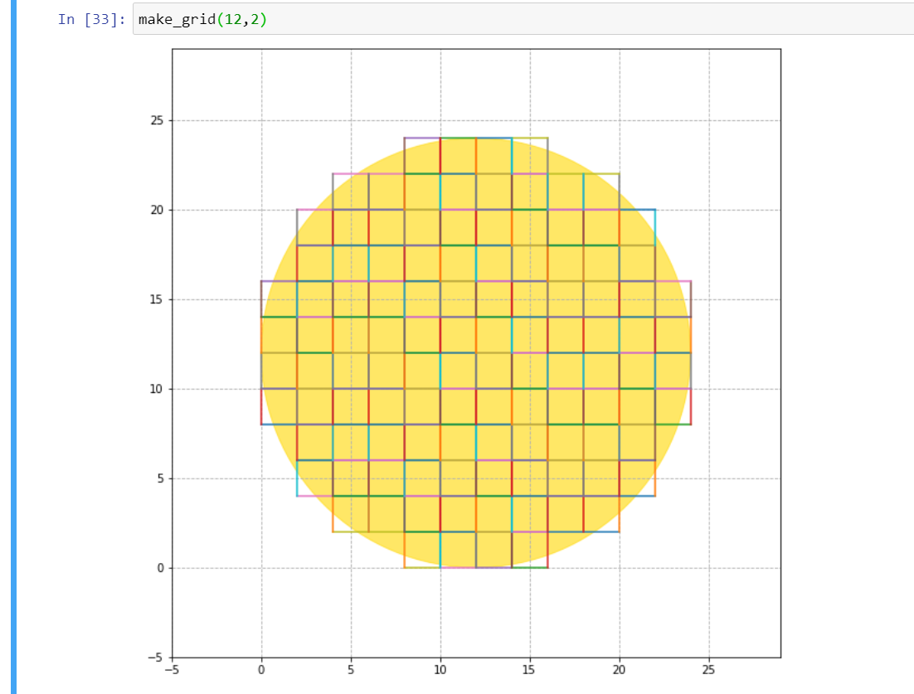

Slide 12
Map Implementation:
Using Cartesian coordinates was straightforward. However, the challenge lies in implementing the same procedure on the surface of a sphere (Earth) in a different coordinate system ([lat,lng]).
Let’s use the PyProj package in Python with the appropriate transformation parameters to transform latitude and longitudes to x and y coordinates and vice versa.
To test, let’s visually see both the map and the cartesian transformation of points
Conclusion: The transformations were verified and they work flawlessly by producing the intended outcome.

Slide 13
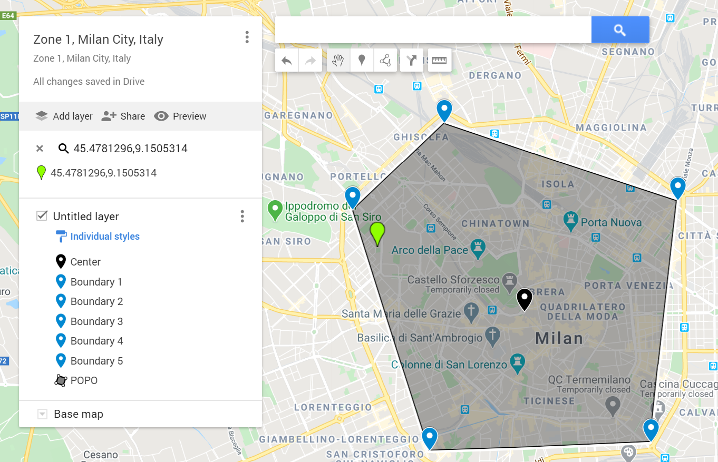

Slide 14
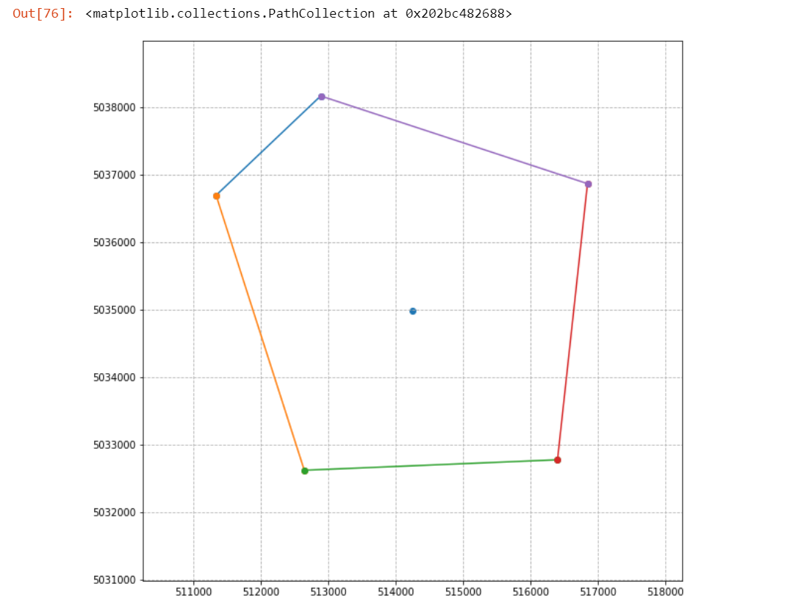

Slide 15
Finding the critical size
The next step in our problem is figuring out the side length of the square cell to be used for grid generation.
The side should be such that when the API is called, it returns just short of 30 entries.
Any decrease in side length would cause lesser than 30 results, and the result bandwidth of the API query will be wasted.
Any more than the critical size, and we would miss out on some venues. (eg: 65 venues exist in reality but the API returns only 30 as that is the cap limit]

Slide 16
Critical Size Continued...
The distribution density of each kind of location mentioned in the ‘Relevant Location types’ section would vary among different regions of our AOI.
As a solution, we appeal to common sense and select a point where there is a high density of such venues known beforehand.
We iteratively find out the critical size and use that as the length of our square as cell length for the grid.
Clearly, the area near ‘VENUS MILANO’ has a high density. Let’s select this region to find the critical size, SW corner = Missori subway stn and NE corner = San Babila subway stn.

Slide 17
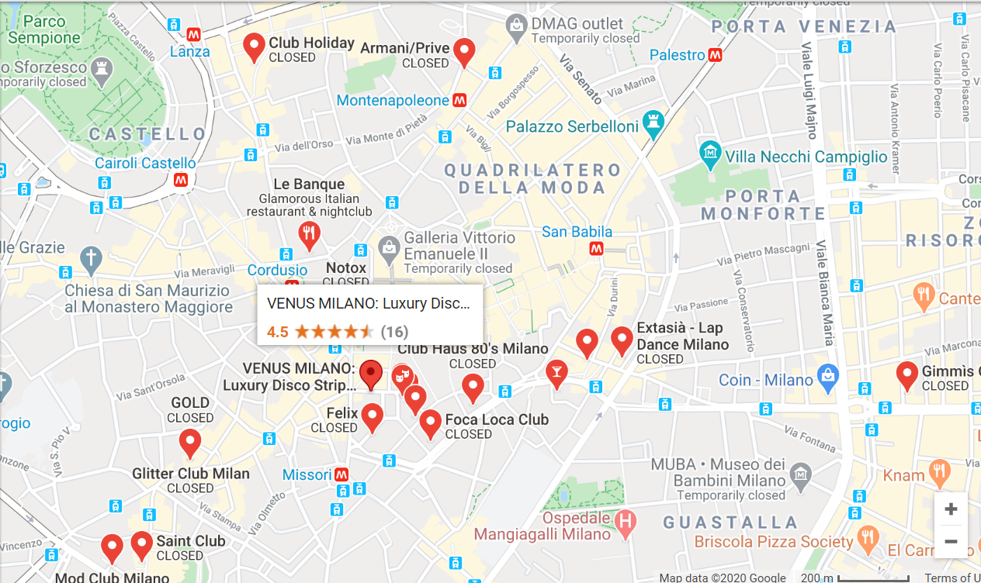

Slide 18
Making the grid on AOI
Now that the AOI and the critical size has been defined, we must fabricate a new version of our ‘make_grid(R,S)’ to return the list of SW corners and the corresponding NE corners of each cell in the grid.
This is one of the most difficult tasks encountered so far.
One can clearly see the 6 Km diameter of the circle. The grid size to AOI scale can be visually seen quite conspicuously.
The number of cells in the grid = 208 = Number of API calls that will be made
The list of SouthWest coordinates and NorthEast coordinates of each cell is returned by the function called ‘map_grid(epicenter,R,s)’.

Slide 19
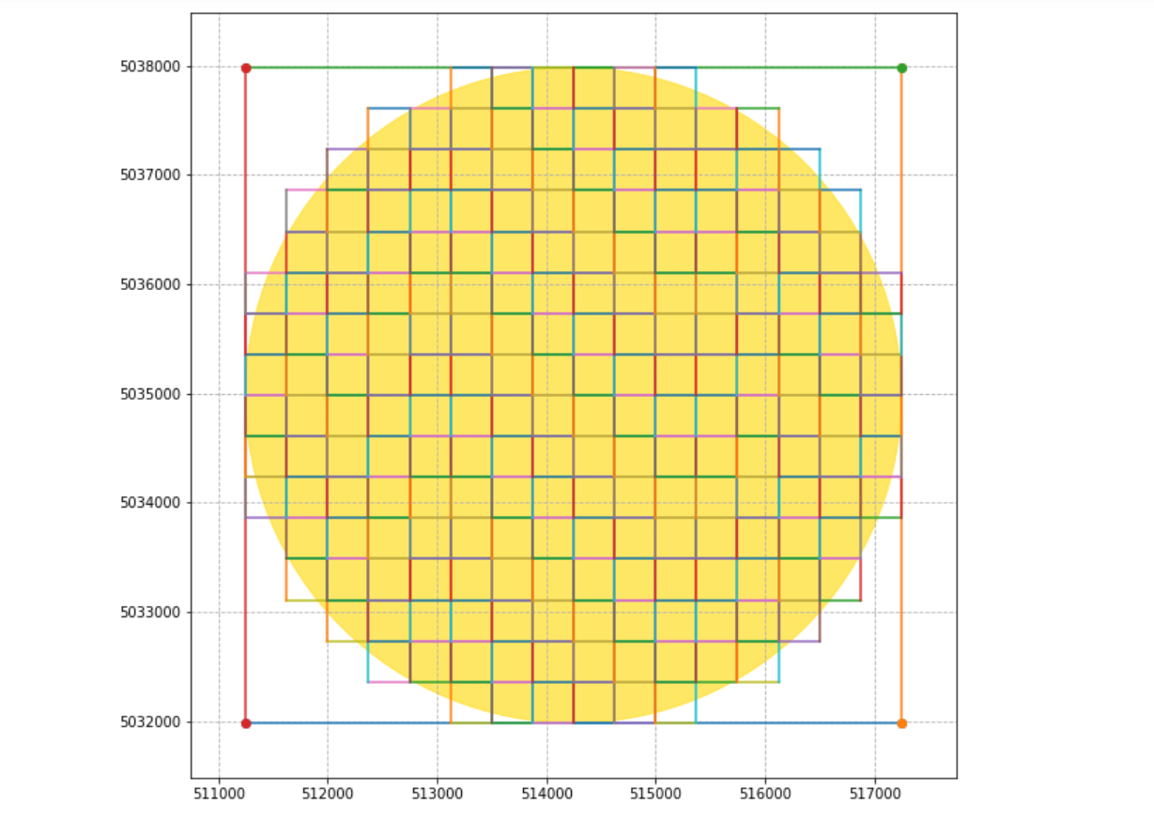

Slide 20
Converting JSON file to clean data frame:
Once the API has been called and the response result obtained, it has to be converted to a clean looking data frame for further concatenation and classificational analysis.
This job is performed perfectly by the ‘venues_to_df()’ function.
This function is to be acted upon every time an API call is made, to get a clean data frame.

Slide 21
Calling the API on all cells:
The main loop may run into errors, so to be safe, I concatenate the resulting data frames of 20 APIs each and then collate them into a list called ‘list_of_df’.
Let’s concatenate all these data frames into one ultimate data frame and write it into a CSV file.
Lets see the picture on the next slide.

Slide 22
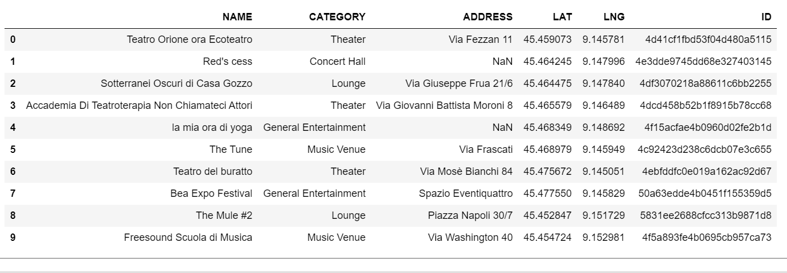

Slide 23
Creating informative labels:
Categories = [Opera House, General Entertainment, Concert Hall, Comedy Club, Amphitheater, Music Venue, Nightclub, Lounge, Theater] are the unique values in the categories column.
Event time: For each category, decide a plausible set of times at which an event/gig/performance can take place.
Event Scale: For each category, decide a plausible set of scales at which an event/gig/performance can take place.
Event Type:For each category, decide a plausible set of event types that can take place.

Slide 24
Conclusion:
After the event type, scale, and time have been decided, the final dataset looks like (see next slide)
Thus, the required comprehensive dataset has been built to assist the agency and all of our target audiences in making choices every day about the venue on the basis of performance type, time, and scale in order to increase their reach, spread their art and at the same time increasing ticket sales.

Slide 25
